Slide 1
Opole Press Conference Suresh Krishna – Vice President of Operations Ed Heffernan – Director of International Operations
POLARIS INDUSTRIES INC.
May 14, 2013

Slide 2
Polaris at a Glance
Manufacturer of high-performance motorized products
Strong distribution channel
1,650 dealers in North America
1,100 dealers Internationally
Productive loyal workforce
~4,900 strong
Customer Focused Product Innovation
2012 Sales by Geography

Slide 3
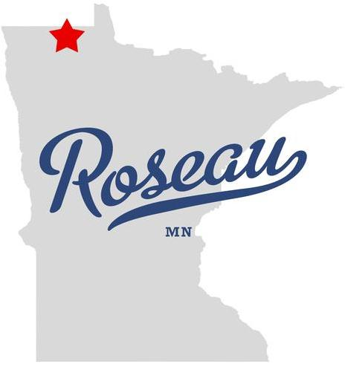
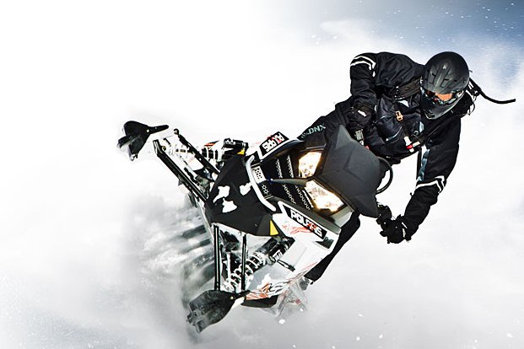
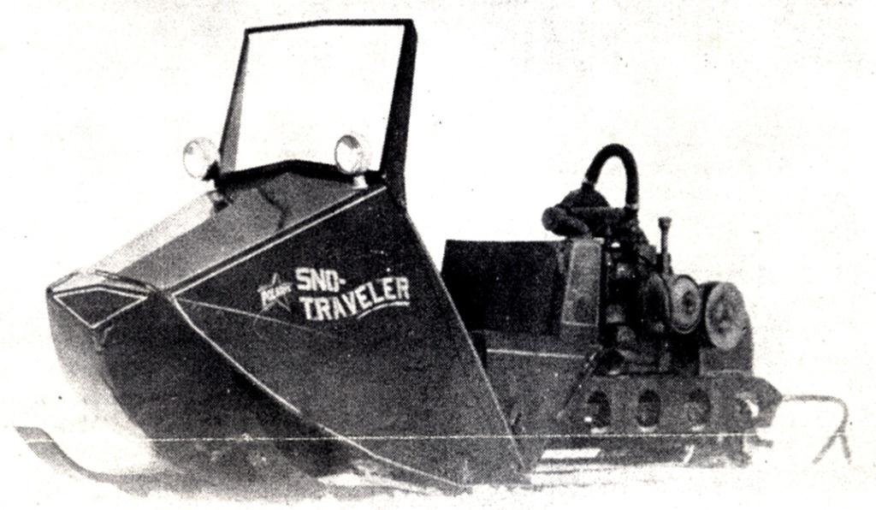
Who Is Polaris?
$3.2 Billion Revenue
Snow <10%
Est. 1954

Slide 4
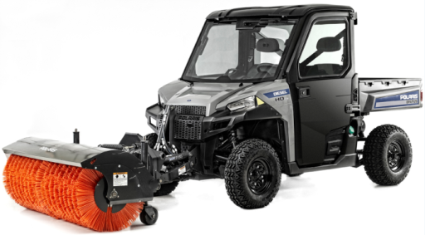
Who Is Polaris?
Commercial
Utility Vehicle

Slide 5
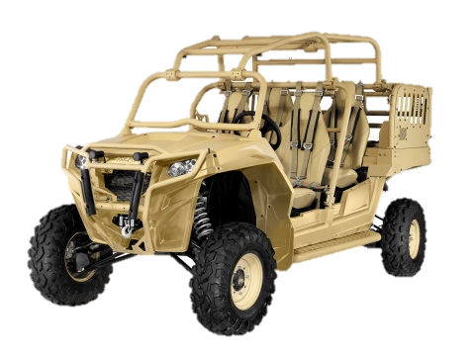
Who Is Polaris?
Special Purpose Vehicles
Military

Slide 6
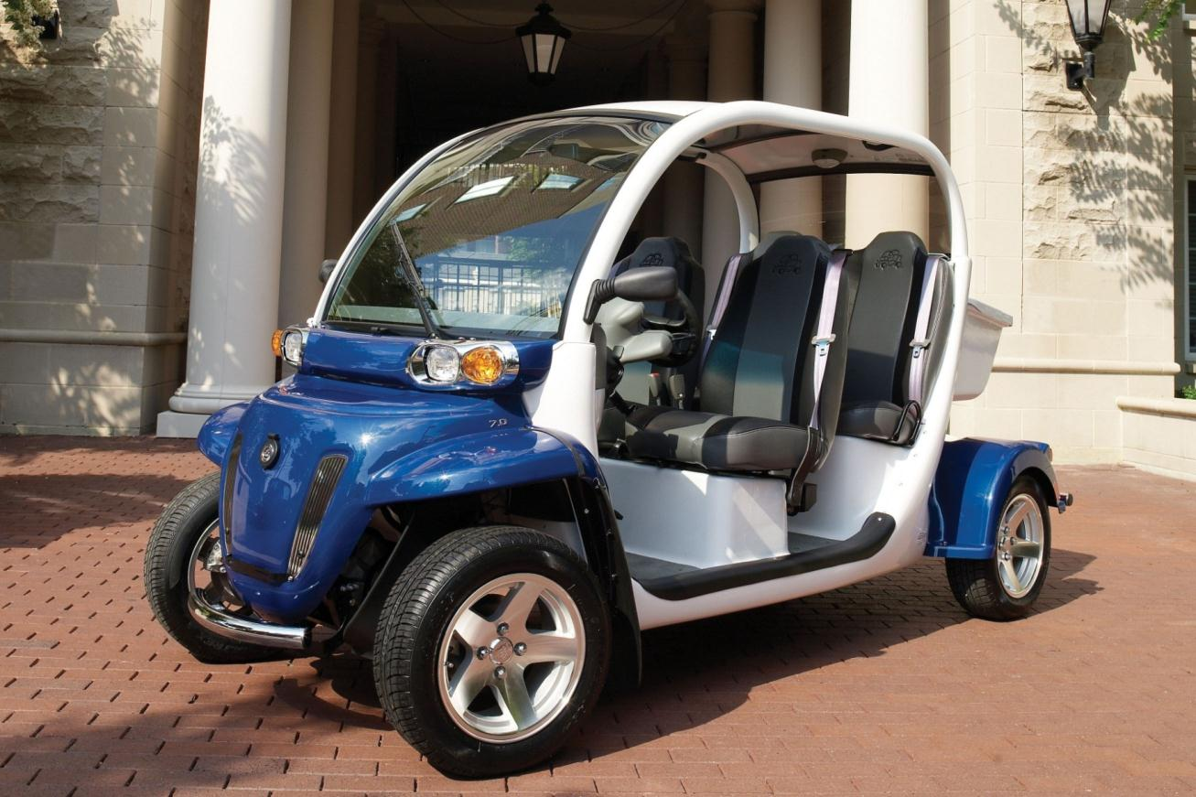
Who Is Polaris?
Electric

Slide 7
Who Is Polaris?
Electric

Slide 8
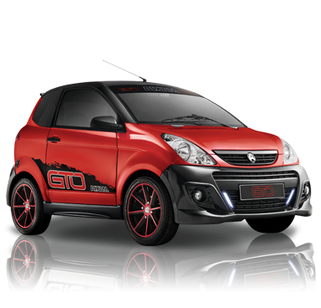
Who Is Polaris?
Electric

Slide 9
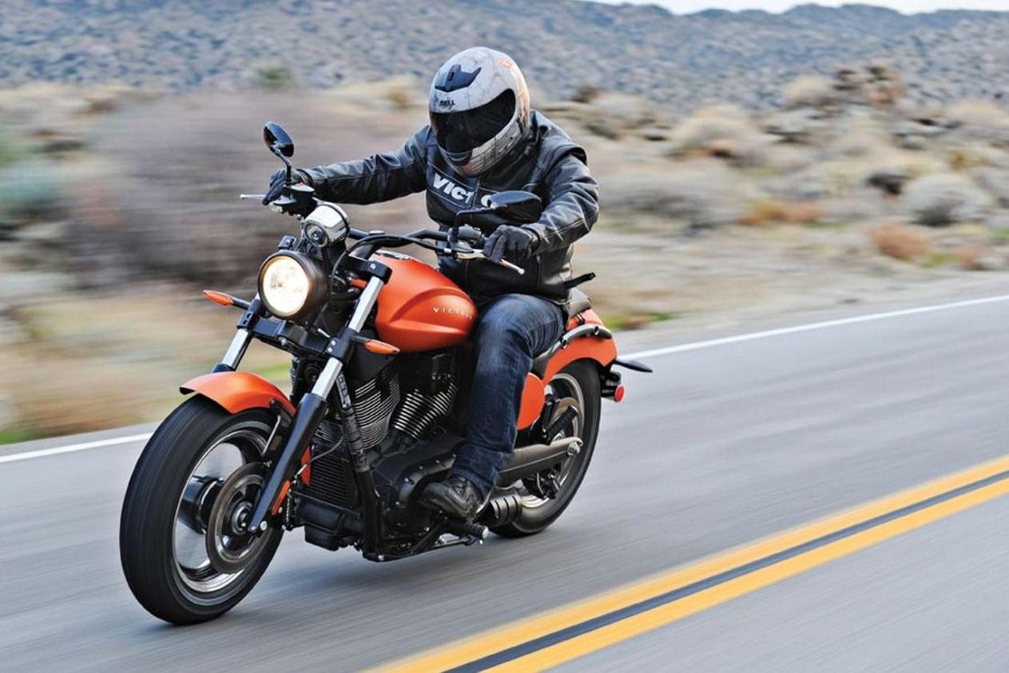
Who Is Polaris?
Heavyweight
Motorcycles

Slide 10
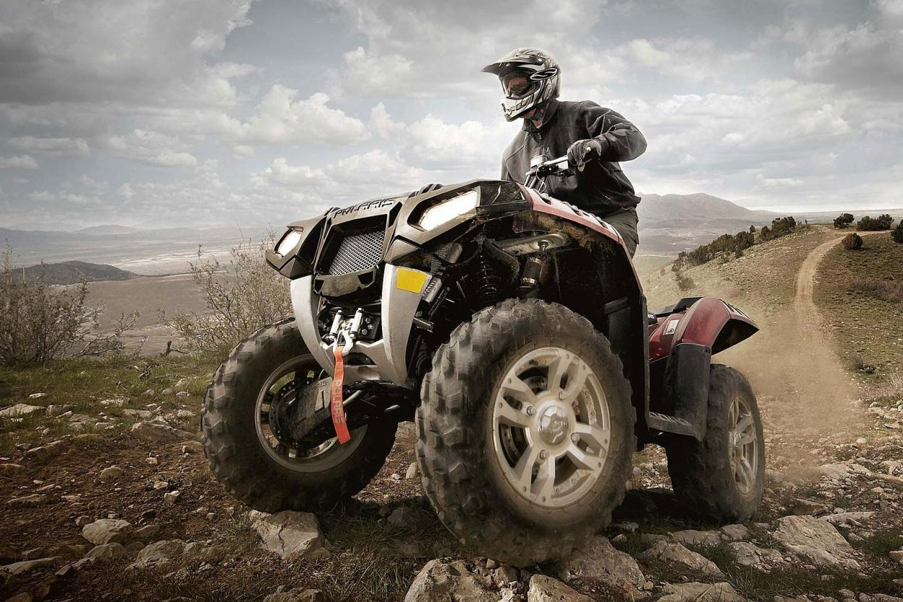
Who Is Polaris?
Off-Road
Vehicles 69%
ATV’s

Slide 11
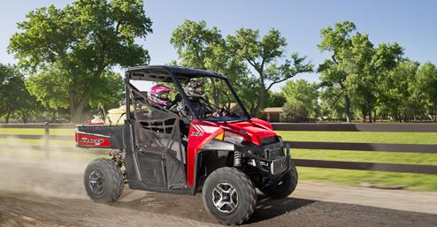
Who Is Polaris?
Off-Road
Vehicles 69%
Ranger
Utility

Slide 12
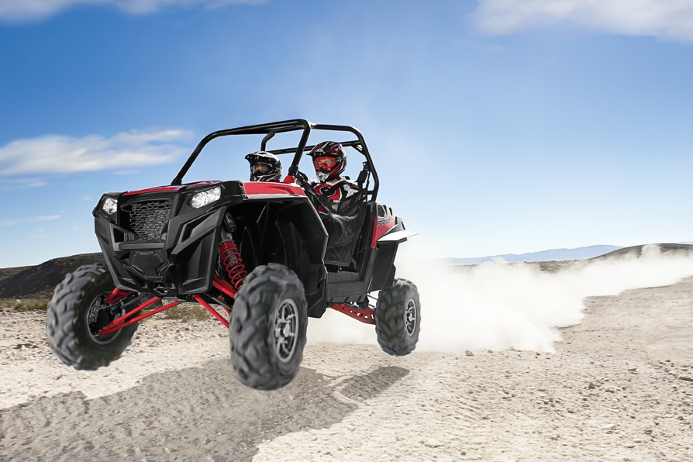
Who Is Polaris?
Off-Road
Vehicles 69%
RZR
Recreational

Slide 13
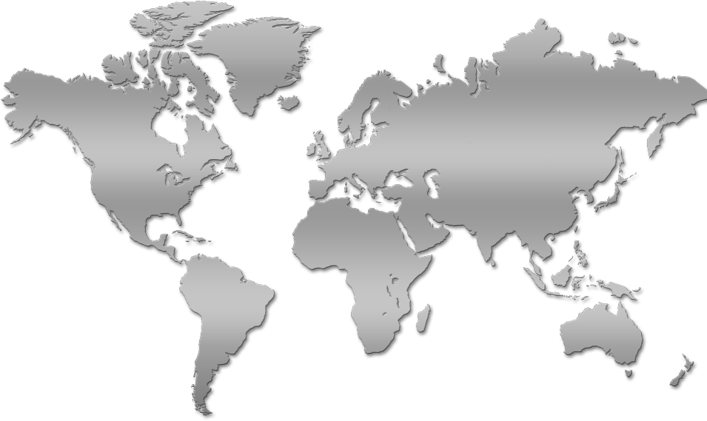
Global Manufacturing Operations
Chanas
FRANCE
Aixam Mega
Roseau
MINNESOTA
Snow, ATV, SxS
Bourran
FRANCE
Goupil
Opole
POLAND
ATV, SxS
Osceola
WISCONSIN
Engines
Spirit Lake/Milford
IOWA
SxS, Motorcycles,
GEM, Commercial
Monterrey, MEXICO
SxS, Engines
Jaipur
INDIA
Eicher JV
 | Current Polaris MFG Locations
 | Future Polaris MFG Locations
Expanding into Europe and Asia

Slide 14
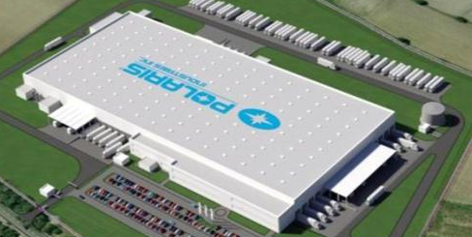
Polaris Poland
Rendering
Ground Breaking 2H 2013
SOP in 2H 2014
Products: Off-Road Vehicles -- ATV, Ranger, RZR
Processes: Weld, Paint and Vehicle Assembly
Design Engineering – Tailor Vehicles for Local Markets

Slide 15
Thank You

